Slide 1
Discrete Random Variables and Probability Distributions
Session 05 - 08
Anom Yudistira

Slide 2
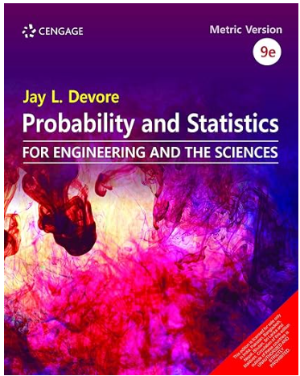
Jay L. Devore. (2020). Probability and Statistics for Engineering and the Sciences, 9E. Cancage Learning, Boston USA. ISBN-13: 978-0-538-73352-6
References

Slide 3
Learning Outcomes
On successful completion of this course, student will be able to:
LO 2: Calculate Descriptive Measures, Probability, Discrete
and Continuous Distribution

Slide 4
Sub Topics
Random Variables
Probability Distributions for Discrete Random Variables
Expected Values
The Binomial Probability distributions
Hypergeometric and Negative Binomial Distributions
The PoissonProbability Distributions

Slide 5
Learning Objectives
LO 2: Calculate Descriptive Measures, Probability, Discrete and Continuous Distribution

Slide 6
Random Variables

Slide 7
Random Variables
A quantitative variable X is a random variable if the value that it assumes, corresponding to the outcome of an experiment is a chance or random event.
Random variables can be discrete or continuous.
Examples:
  X = TPA score for a randomly selected student
  X = number of people in a room at a randomly selected time of day
  X = number on the upper face of a randomly tossed die

Slide 8
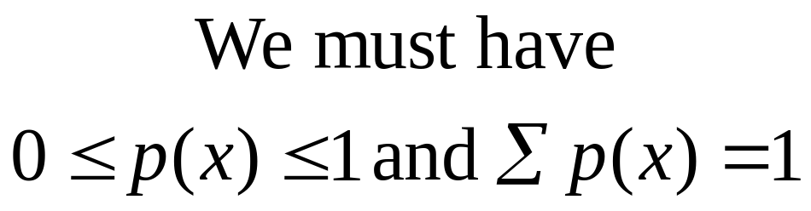
Probability Distributions for Discrete Random Variables
The probability distribution for a discrete random variable X resembles the relative frequency distributions we constructed on the previous slide. It is a graph, table or formula that gives the possible values of x and the probability p(x) associated with each value.

Slide 9
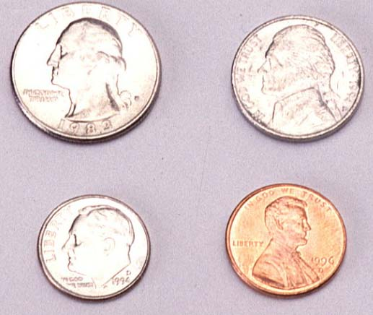
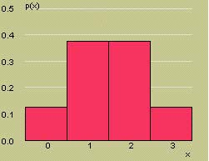
Example
Toss a fair coin three times and define x = number of heads.
x
3
2
2
2
1
1
1
0
HHH
x | p(x)
0 | 1/8
1 | 3/8
2 | 3/8
3 | 1/8
1/8
1/8
1/8
1/8
1/8
1/8
1/8
1/8
P(x = 0) = 1/8
P(x = 1) = 3/8
P(x = 2) = 3/8
P(x = 3) = 1/8
HHT
HTH
THH
HTT
Probability Histogram for x
THT
TTH
TTT

Slide 10
Probability Distribution

Slide 11
Probability Distribution
Probability distributions can be used to describe the population, just as we described samples on previous slide.
  Shape: Symmetric, skewed, mound-shaped…
  Outliers: unusual or unlikely measurements
  Center and spread: mean and standard deviation. A population mean is called μ and a population standard deviation is called σ.

Slide 12
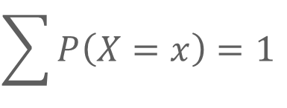
Probability Distribution
The probability function
  May be tabular:
x | 1 | 2 | 3
P(X=x) | 1/2 | 1/3 | 1/6
$$\sum{P\left(X=x\right)=1}$$

Slide 13
Probability Distribution
The probability function
  May be graphical:
.50
.33
.17
1
2
3

Slide 14
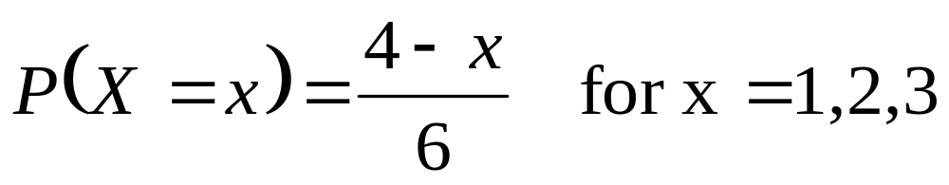
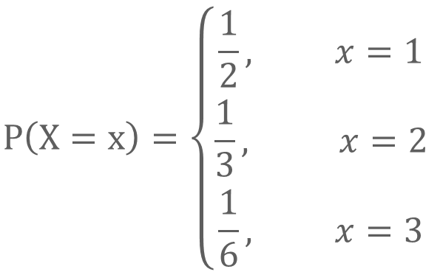
Probability Distribution
The probability function
  May be formulaic:
$$P\left(X=x\right)=\left\{\begin{matrix}\frac{1}{2}, x=1 \\ \frac{1}{3}, x=2 \\ \frac{1}{6}, x=3\end{matrix}\right.$$

Slide 15
Probability Distribution
The probability function
  Another example, rolling a fair die
x | 1 | 2 | 3 | 4 | 5 | 6
P(X=x) | 1/6 | 1/6 | 1/6 | 1/6 | 1/6 | 1/6

Slide 16
Probability Distribution
The probability function
  Another example, rolling a fair die
.50
.33
.17
1
2
3
4
5
6

Slide 17
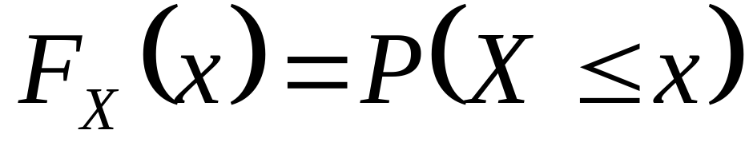
Probability Distribution
Cumulative probability distribution
  The cdf is a function which describes the probability that a random variable does not exceed a value

Slide 18
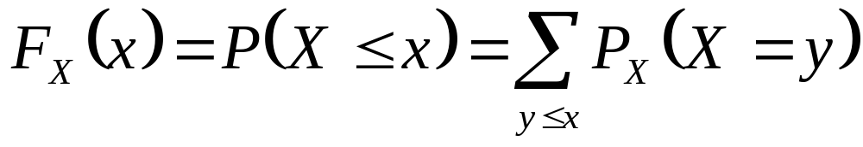
Probability Distribution
Cumulative probability distribution
  The relationship between the cdf and the probability function:

Slide 19
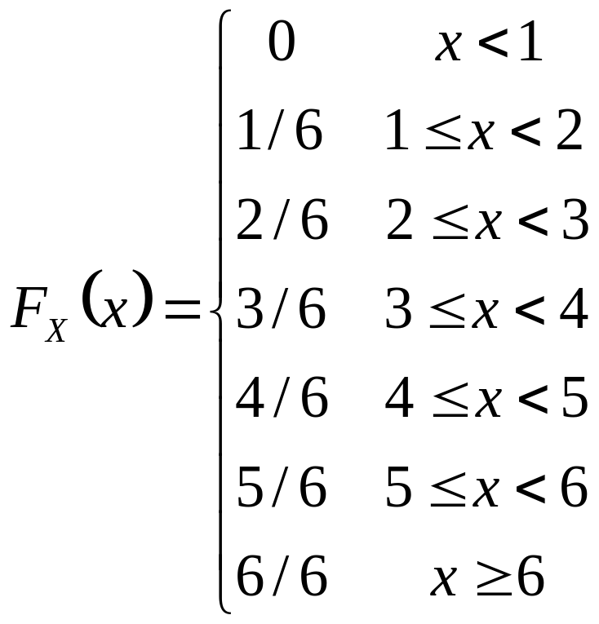
Probability Distribution
Cumulative probability distribution
  May be tabular (die-throwing):

Slide 20
Probability Distribution
Cumulative probability distribution
  May be graphical (die-throwing):
1
1
2
3
4
5
6

Slide 21
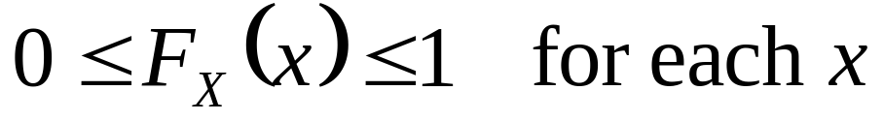
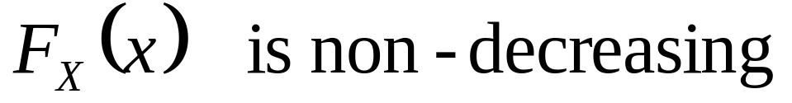
Probability Distribution
The cdf, properties

Slide 22
Expectation Value

Slide 23
Expectation Value
The expectation of a random variable is just its “average” or “expected” level
  This is a measure of central tendency, but for random variables instead of datasets
  It is calculated in the natural way: Each value a random variable may take is weighted by the probability of it taking that value

Slide 24
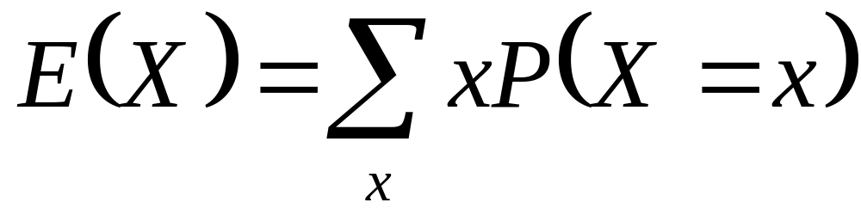
Expectation Value
Each value a random variable may take is weighted by the probability of it taking that value

Slide 25
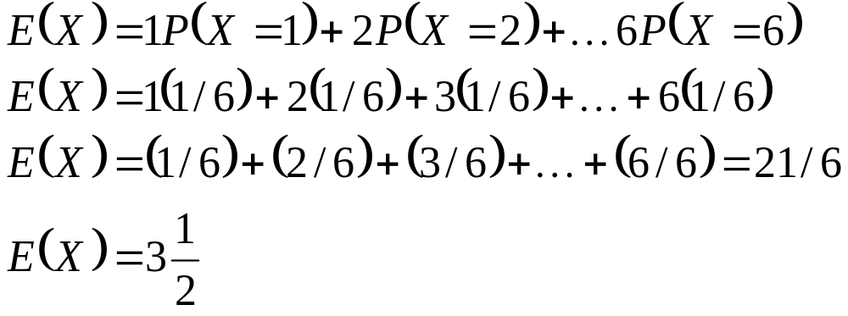
Expectation Value
Example, die throw

Slide 26
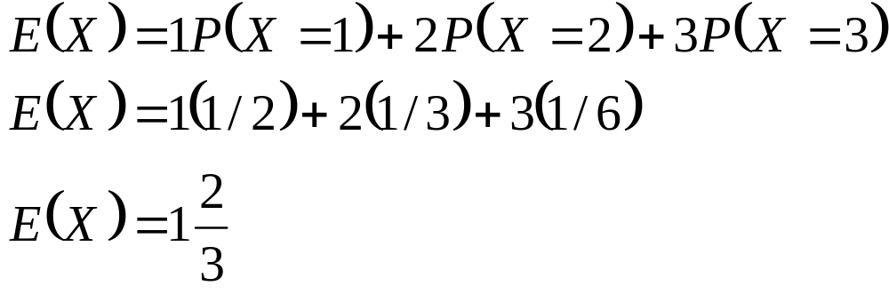
Expectation Value
Another example
x | 1 | 2 | 3
P(X=x) | 1/2 | 1/3 | 1/6

Slide 27
Variance
The variance of a random variable is its expected squared deviation from its mean.
  A measure of dispersion for random variables
  Similar to the measure of dispersion of the same name for datasets
  Is calculated in the natural way: Each value a random variable could take is subtracted from its expectation, squared, and weighted by its probability of occurrence

Slide 28
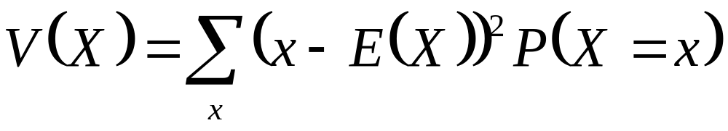

Variance
Each value a random variable could take is subtracted from its expectation, squared, and weighted by its probability of occurrence
Another notation of variance is $σ^{2}$

Slide 29
Variance
  Example, die throw
  $E\left(X\right)=3\frac{1}{2}$
x
x-E(X)
(x-E(X))²
P(X=x)
Product
1
-2.5
6.25
1/6
1.042
2
-1.5
2.25
1/6
0.375
3
-0.5
0.25
1/6
0.042
4
0.5
0.25
1/6
0.042
5
1.5
2.25
1/6
0.375
6
2.5
6.25
1/6
1.042
Tot
2.918

Slide 30
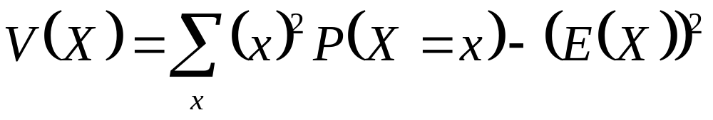
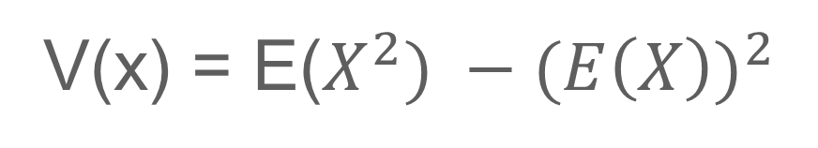
Variance
  Alternative Formula
V(x) = E($X^{2}) −{(E\left(X\right))}^{2}$

Slide 31
Variance
  Example, die throw
x
x²
P(X=x)
Product
1
1
1/6
1/6
2
4
1/6
2/3
3
9
1/6
1 ½
4
16
1/6
2 2/3
5
25
1/6
4 1/3
6
36
1/6
6
Tot
15 1/6

Slide 32
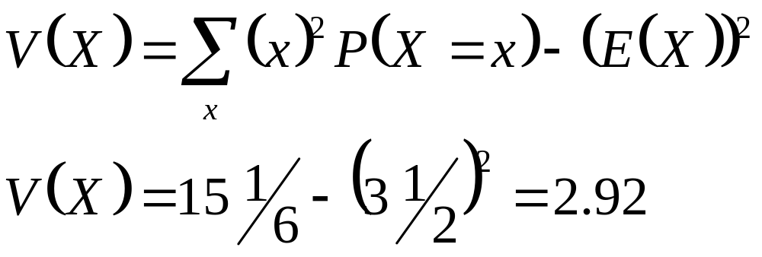
Variance
  Example, die throw

Slide 33
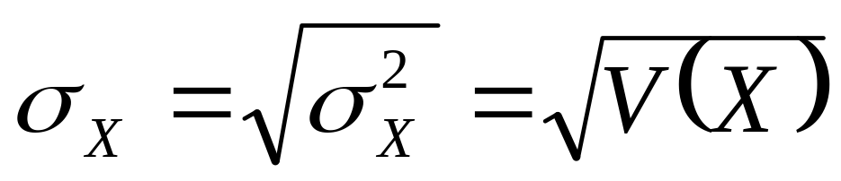
Standard deviation
  Standard deviation: as in the case of describing data, it is easier to work in standard deviations

Slide 34
The Binomial Probability Distributions

Slide 35
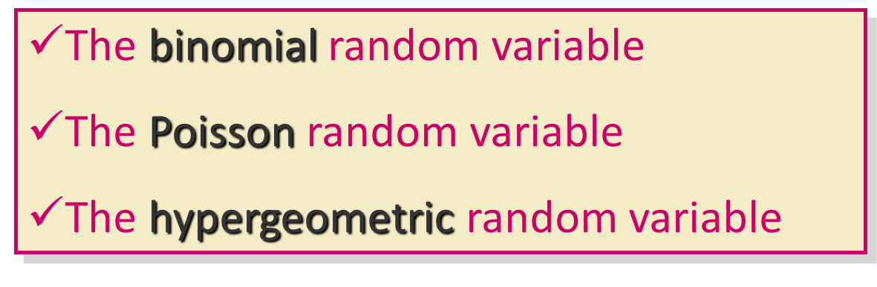
Introduction
Discrete random variables take on only a finite or countably number of values.
Three discrete probability distributions serve as models for a large number of practical applications:

Slide 36
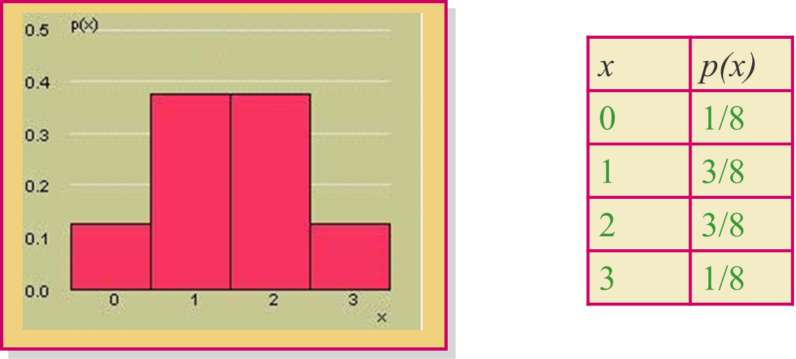
The Binomial Random Variable
The coin-tossing experiment is a simple example of a binomial random variable. Toss a fair coin n = 3 times and record x = number of heads.

Slide 37

The Binomial Random Variable
Many situations in real life resemble the coin toss, but the coin is not necessarily fair, so that P(H) ≠ 1/2.
Example: A geneticist samples 10 people and counts the number who have a gene linked to Alzheimer’s disease.
Coin:
Head:
Tail:
Person
Number of
tosses:
P(H):
n = 10
Has gene
P(has gene) = proportion in the population who have the gene.
Doesn’t have gene

Slide 38
The Binomial Experiment
The experiment consists of n identical trials.
Each trial results in one of two outcomes, success (S) or failure (F).
The probability of success on a single trial is p and remains constant from trial to trial. The probability of failure is q = 1 – p.
The trials are independent.
We are interested in x, the number of successes in n trials.

Slide 39
Binomial or Not?
Very few real life applications satisfy these requirements exactly.
Select two people from the U.S. population, and suppose that 15% of the population has the Alzheimer’s gene.
  For the first person, p = P(gene) = .15
  For the second person, p ≈ P(gene) = .15, even though one person has been removed from the population.

Slide 40
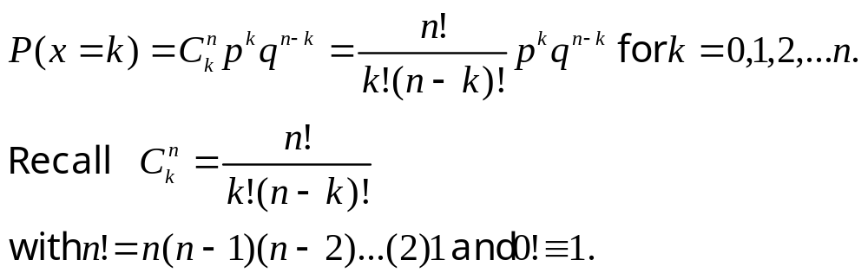
The Binomial Probability Distribution
For a binomial experiment with n trials and probability p of success on a given trial, the probability of k successes in n trials is

Slide 41
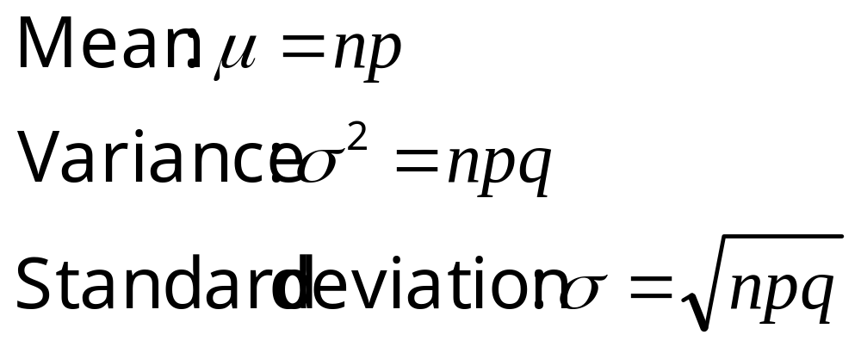
The Mean and Standard Deviation
For a binomial experiment with n trials and probability p of success on a given trial, the measures of center and spread are:

Slide 42

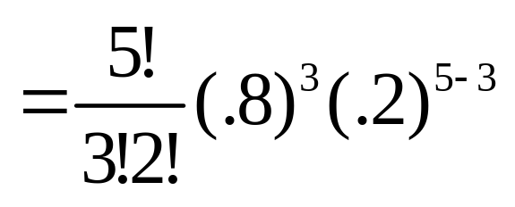
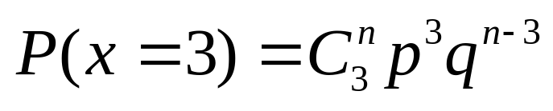
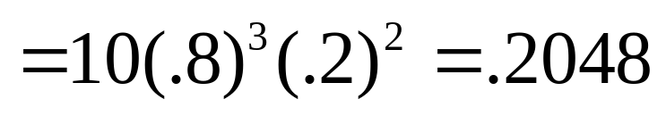
Example
A marksman hits a target 80% of the
time. He fires five shots at the target. What is the probability that exactly 3 shots hit the target?
n =
hit
p =
.8
x =
# of hits
5
success =

Slide 43
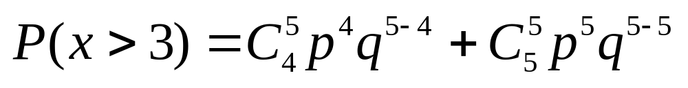
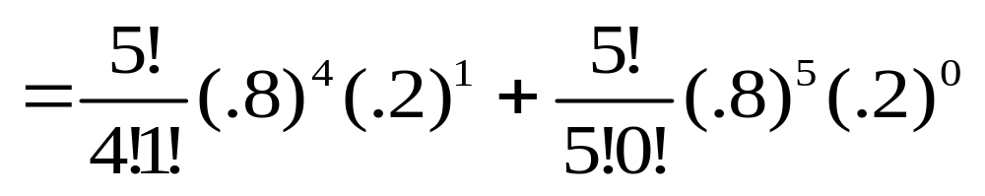
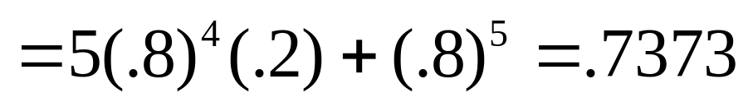
Example
What is the probability that more than 3 shots hit the target?

Slide 44
Cumulative Probability Tables
You can use the cumulative probability tables to find probabilities for selected binomial distributions.
Find the table for the correct value of n.
Find the column for the correct value of p.
The row marked “k” gives the cumulative probability, P(x ≤ k) = P(x = 0) +…+ P(x = k)

Slide 45
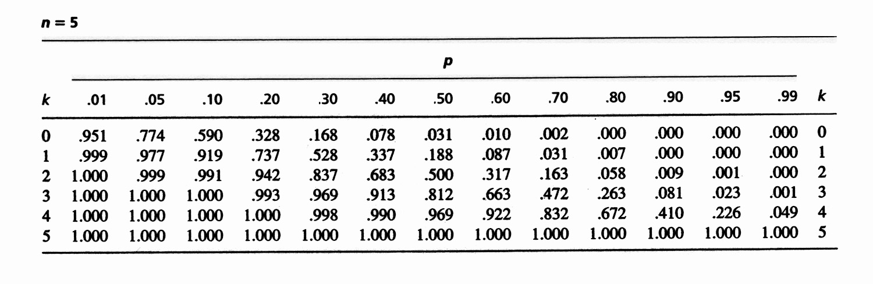
Example
k | p = .80
0 | .000
1 | .007
2 | .058
3 | .263
4 | .672
5 | 1.000
What is the probability that exactly 3 shots hit the target?
P(x = 3) = P(x ≤ 3) – P(x ≤ 2)
= .263 - .058
= .205
Check from formula: P(x = 3) = .2048

Slide 46
Example
k | p = .80
0 | .000
1 | .007
2 | .058
3 | .263
4 | .672
5 | 1.000
What is the probability that more than 3 shots hit the target?
P(x > 3) = 1 - P(x ≤ 3)
= 1 - .263 = .737
Check from formula: P(x > 3) = .7373

Slide 47
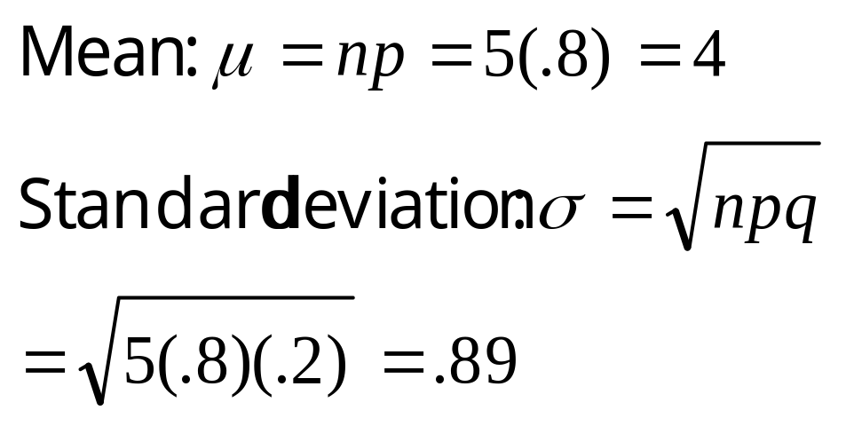
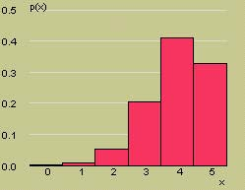
Example
Here is the probability distribution for x = number of hits. What are the mean and standard deviation for x?
μ

Slide 48
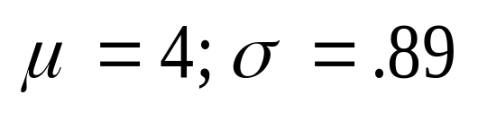
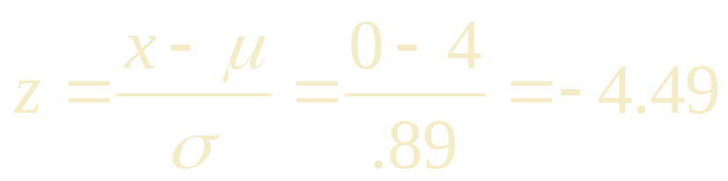
Example
Would it be unusual to find that none of the shots hit the target?
The value x = 0 lies
more than 4 standard deviations below the mean. Very unusual.
μ

Slide 49
The Poisson Probability Distributions

Slide 50
The Poisson Random Variable
The Poisson random variable X is a model for data that represent the number of occurrences of a specified event in a given unit of time or space.
Examples:
  The number of calls received by a switchboard during a given period of time.
  The number of machine breakdowns in a day
  The number of traffic accidents at a given intersection during a given time period.

Slide 51
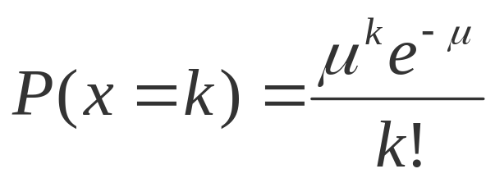
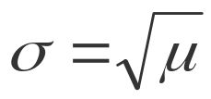
The Poisson Probability
Distribution
x is the number of events that occur in a period of time or space during which an average of μ such events can be expected to occur. The probability of k occurrences of this event is
For values of k = 0, 1, 2, … The mean and standard deviation of the Poisson random variable are
Mean: μ
Standard deviation:

Slide 52

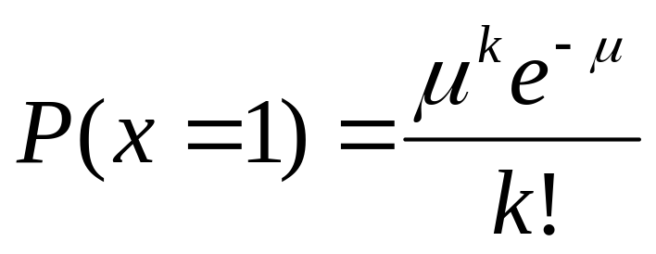
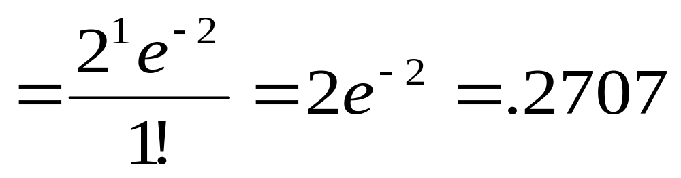
Example
The average number of traffic accidents on a certain section of highway is two per week. Find the probability of exactly one accident during a one-week period.

Slide 53
Cumulative Probability Tables
You can use the cumulative probability tables to find probabilities for selected Poisson distributions.
Find the column for the correct value of μ.
The row marked “k” gives the cumulative probability, P(x ≤ k) = P(x = 0) +…+ P(x = k)

Slide 54
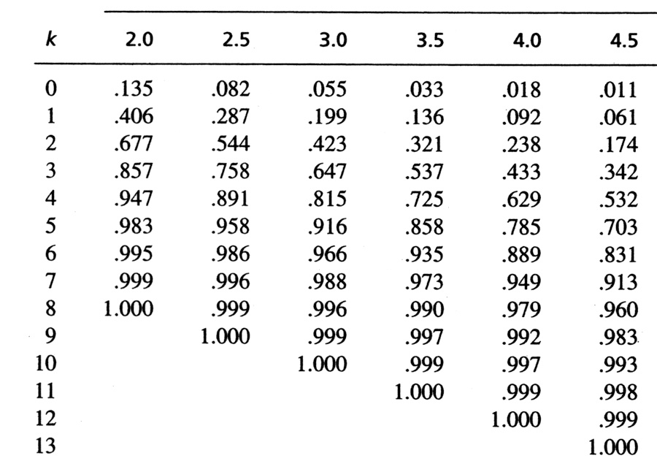
Example
What is the probability that there is exactly 1 accident?
k | μ = 2
0 | .135
1 | .406
2 | .677
3 | .857
4 | .947
5 | .983
6 | .995
7 | .999
8 | 1.000
P(x = 1) = P(x ≤ 1) – P(x ≤ 0)
= .406 - .135
= .271
Check from formula: P(x = 1) = .2707

Slide 55
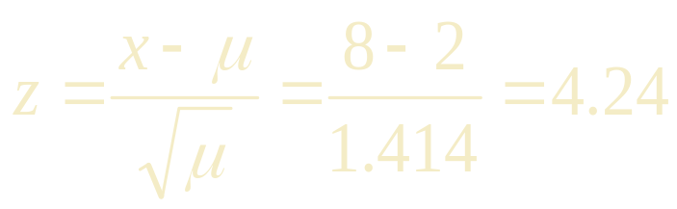
Example
k | μ = 2
0 | .135
1 | .406
2 | .677
3 | .857
4 | .947
5 | .983
6 | .995
7 | .999
8 | 1.000
What is the probability that 8 or more accidents happen?
P(x ≥ 8) = 1 - P(x < 8)
= 1 – P(x ≤ 7)
= 1 - .999 = .001
This would be very unusual (small probability) since x = 8 lies
standard deviations above the mean.

Slide 56
Hypergeometric Distributions

Slide 57
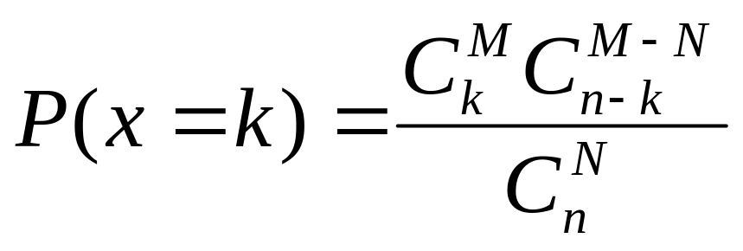
The Hypergeometric Probability Distribution
The “M&M® problems” on the previous slide are modeled by the hypergeometric distribution.
A bowl contains M red candies and N-M blue candies. Select n candies from the bowl and record x the number of red candies selected. Define a “red M&M®” to be a “success”.
The probability of exactly k successes in n trials is

Slide 58
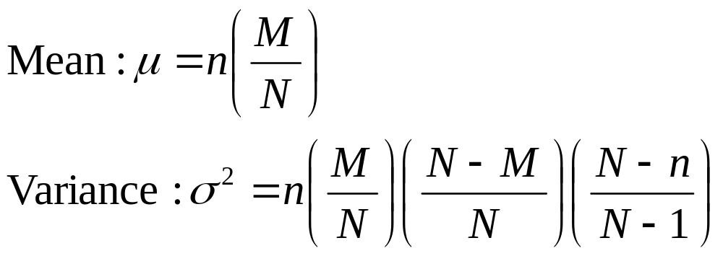
The Mean and Variance
The mean and variance of the hypergeometric random variable x resemble the mean and variance of the binomial random variable:

Slide 59
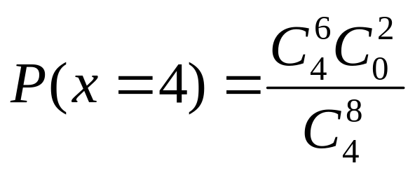
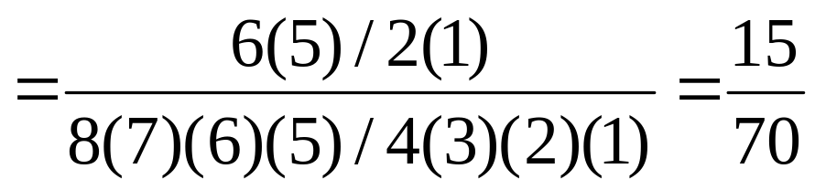
Example
A package of 8 AA batteries contains 2 batteries that are defective. A student randomly selects four batteries and replaces the batteries in his calculator. What is the probability that all four batteries work?
Success = working battery
N = 8
M = 6
n = 4

Slide 60
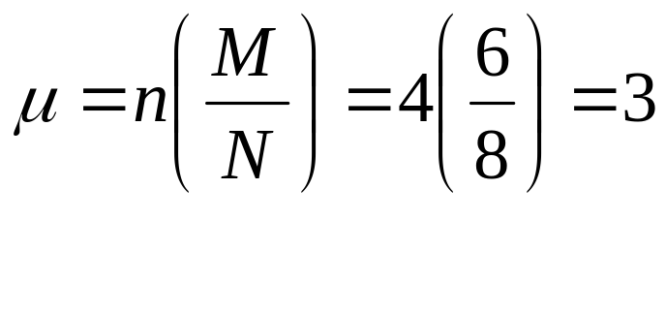
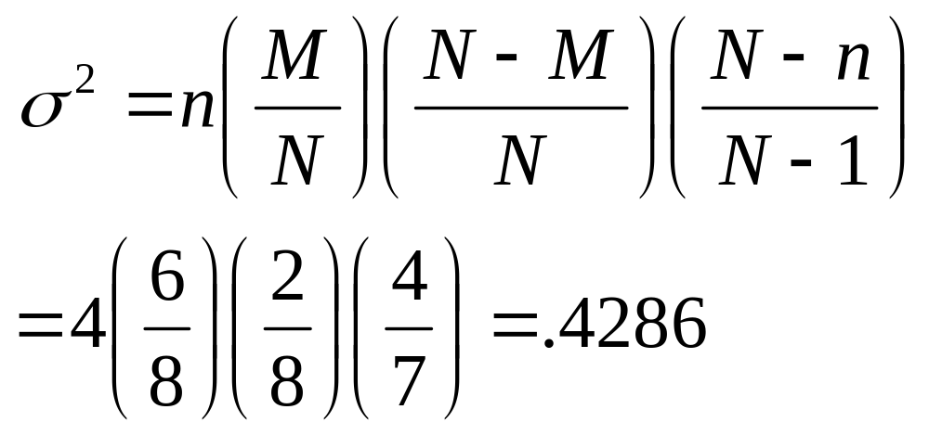
Example
What are the mean and variance for the number of batteries that work?

Slide 61
Thank you
R Programming
Februay 2023

Slide 62
References
Jay L. Devore. (2020). Probability and Statistics for Engineering and the Sciences, 9E. Cancage Learning, Boston USA. ISBN-13: 978-0-538-73352-6

